Slide 1







Introduction to Selenium
What is Selenium?
Brief History
Selenium is an
open-source automation framework
for
Created in 2004 by Jason Huggins, Selenium evolved from a JavaScript tool to a comprehensive testing ecosystem.
testing web applications across different browsers and
platforms.
Language Support
Key Components
Supports multiple programming languages including Python, Java, C#, Ruby, and JavaScript.
Selenium WebDriver
: Interface for test creation and execution
Selenium IDE
: Record and playback tool
Use Cases
Selenium Grid
: Parallel test execution
Beyond testing, Selenium is widely used for web scraping, automation, and data extraction tasks.
Selenium enables automated interaction with web browsers, making it perfect for repetitive tasks and data collection from websites.

Slide 2
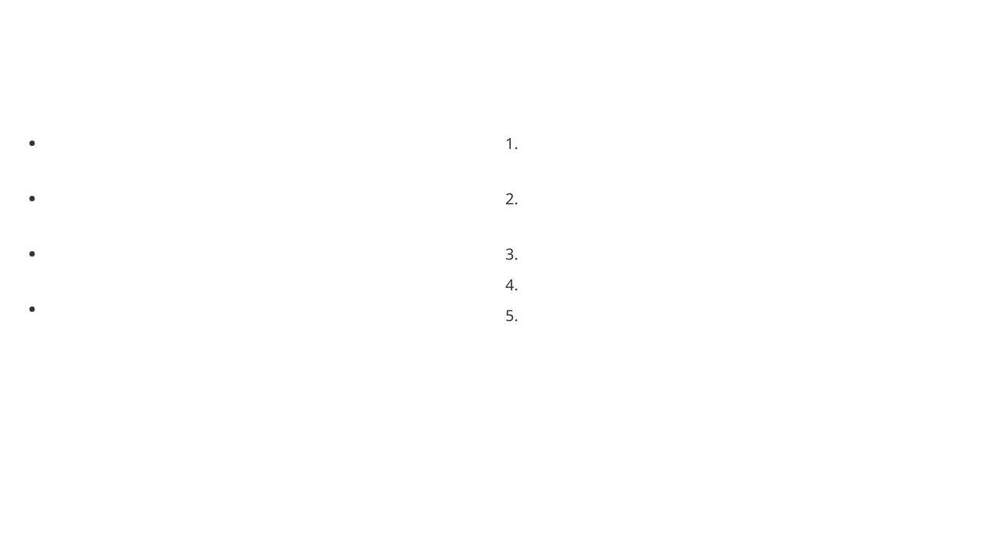




Selenium WebDriver Architecture
Key Components
How It Works
Client Libraries
Client code
: Language-specific bindings (Python, Java, C#, etc.) that provide the WebDriver API
calls WebDriver methods using language bindings
JSON Wire Protocol/W3C Protocol
Commands are serialized
: RESTful web service that defines communication between client and driver
into JSON and sent via HTTP requests
Browser Drivers
Browser driver
receives and interprets the JSON commands
: Browser-specific implementations (ChromeDriver, GeckoDriver, EdgeDriver)
Driver controls browser
through native automation APIs
Real Browsers
Results are returned
: Chrome, Firefox, Safari, Edge, and other web browsers
back through the same communication path
Communication Flow
Key Benefits
The architecture follows a client-server model where commands flow through HTTP requests and responses, enabling cross-platform automation.
Language-agnostic automation
Cross-browser compatibility
Standardized communication protocol
Test_Selenium.py
Scalable and maintainable architecture

Slide 3

WebDriver Setup and Configuration
From Our NDTV Code
Key Setup Components
def setup_driver():
chrome_options = Options()
service = Service(ChromeDriverManager().install())
driver = webdriver.Chrome(
service=service,
options=chrome_options
)
return driver
Options
: Browser-specific configurations
Service
: Manages the driver executable
WebDriver
: Main interface to the browser
ChromeDriverManager
: Automatic driver installation

Slide 4
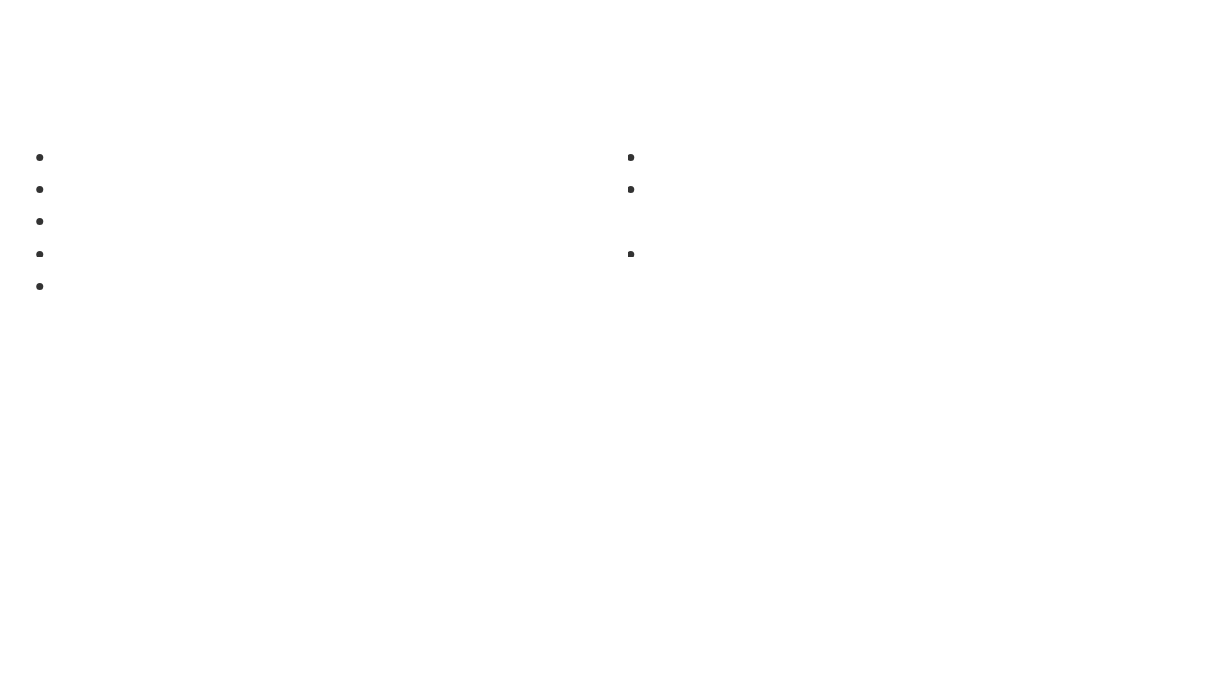



Navigation and Page Loading
Navigation Methods
Page Loading Techniques
driver.get(url)
: Navigate to URL and wait for page load
driver.get()
waits for the
onload
event
driver.navigate().to(url)
: Navigate without waiting
Use
WebDriverWait
for dynamic content
driver.navigate().back()
: Go back in history
Handle cookies and popups that may block navigation
driver.navigate().forward()
: Go forward in history
Check page readiness with
document.readyState
driver.navigate().refresh()
: Reload current page
Common Challenges
From NDTV Example
Single-page applications (SPAs) may not trigger onload
driver.get("https://www.ndtv.com")
AJAX content loads asynchronously
Iframes require special handling
Network issues can cause timeouts

Slide 5


Element Location Strategies
Common Locator Types
In Our NDTV Code
By.ID
: Fastest and most reliable
The code uses multiple strategies for robustness:
By.CSS_SELECTOR
: Powerful and flexible
driver.find_elements(By.CSS_SELECTOR, selector)
By.XPATH
: Most versatile but slower
For specific elements:
By.TAG_NAME
: Find elements by HTML tag
By.CLASS_NAME
: Find by CSS class
driver.find_element(By.CSS_SELECTOR, ".story-title")
Multiple selectors are tried in sequence to ensure elements are found even if page structure changes.

Slide 6
CSS Selector Basics
Element Selection by ID & Class
#username
/* Select by ID */
.btn-primary
/* Select by class */
input
/* Select by tag name */
Attribute Selectors
input[name="q"]
/* Exact match */
a[href*="login"]
/* Contains */
input[type^="text"]
/* Starts with */
Selenium Implementation
driver.find_element(By.CSS_SELECTOR, "#username")
driver.find_element(By.CSS_SELECTOR, ".btn-primary")
driver.find_element(By.CSS_SELECTOR, "input[name='q']")

Slide 7
Advanced CSS Selectors
Combined Selectors
input#username.form-control[type="text"]
Relationship Selectors
div > p
/* Child: direct children only */
h1 + p
/* Adjacent sibling */
Position-Based Selection
li:first-child
/* First child element */
li:nth-child(2)
/* Second child element */

Slide 8
Selenium Usage & Benefits
Selenium Implementation
driver.find_element(By.CSS_SELECTOR, "#login")
driver.find_element(By.CSS_SELECTOR, ".btn-primary")
driver.find_element(By.CSS_SELECTOR, "div.container > input#username")
Why CSS Selectors Are Preferred
Faster than XPath in most browsers
More compact syntax
Matches frontend developer conventions
Quick Reference
#id
→ ID
.class
→ Class
tag
→ Tag name
[attr=value]
→ Attribute-based

Slide 9



Waiting Mechanisms
Explicit Waits
Implicit Waits
Waits for a certain condition to occur before proceeding.
Sets a default wait time for the entire WebDriver session.
WebDriverWait(driver, 10).until(
driver.implicitly_wait(10) # seconds
EC.presence_of_element_located((By.TAG_NAME, "body"))
)
Best Practices
More precise control over wait conditions
Use explicit waits for specific conditions
Used in NDTV code for waiting for page load
Avoid mixing implicit and explicit waits
Set reasonable timeout values

Slide 10
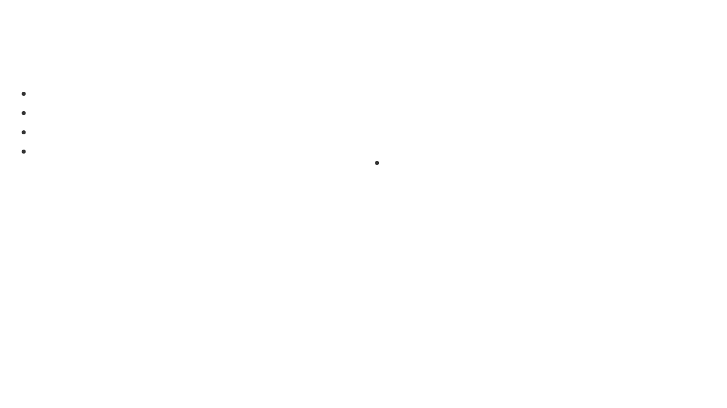


Data Extraction Techniques
Element Data Methods
From NDTV Example
element.text
: Get visible text content
title = element.text.strip()
element.get_attribute("attribute")
: Get any attribute value
link = element.get_attribute("href")
element.get_attribute("innerHTML")
: Get HTML content
Data Cleaning
element.is_displayed()
: Check visibility
Use
.strip()
to remove whitespace
Filter out ads and unwanted content
Check for empty values before processing

Slide 11
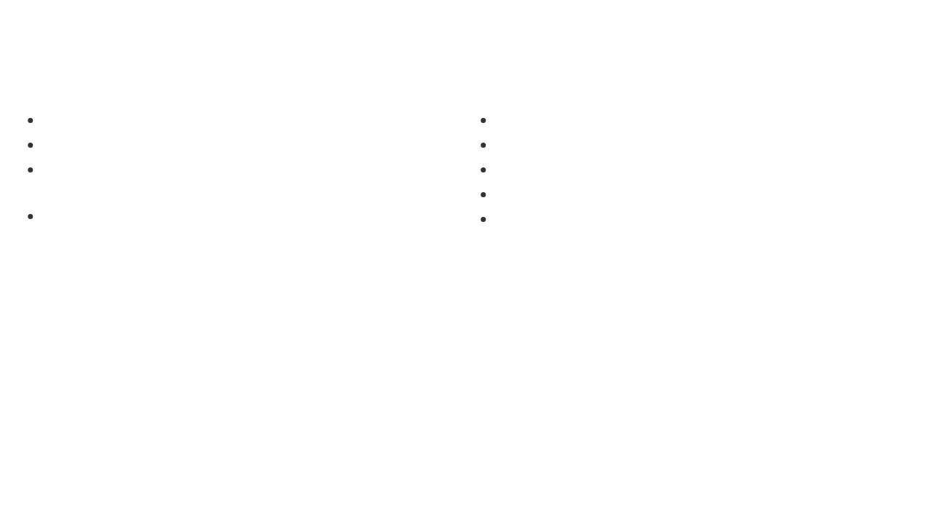

Error Handling and Best Practices
Common Exceptions
Best Practices
NoSuchElementException
: Element not found
Use
try/except
blocks for error handling
TimeoutException
: Wait condition not met
Implement
multiple selector strategies
for robustness
StaleElementReferenceException
: Element no longer attached to DOM
Add
proper waits
before interacting with elements
Use
finally
blocks to ensure driver cleanup
ElementNotInteractableException
: Element not interactable
Implement
retry mechanisms
for intermittent failures
From NDTV Example
Robust Approach
try:
The NDTV code demonstrates robustness by:
# Element operations
Trying multiple selectors
except Exception as e:
Gracefully handling missing elements
continue
Ensuring driver cleanup with try/finally

Slide 12
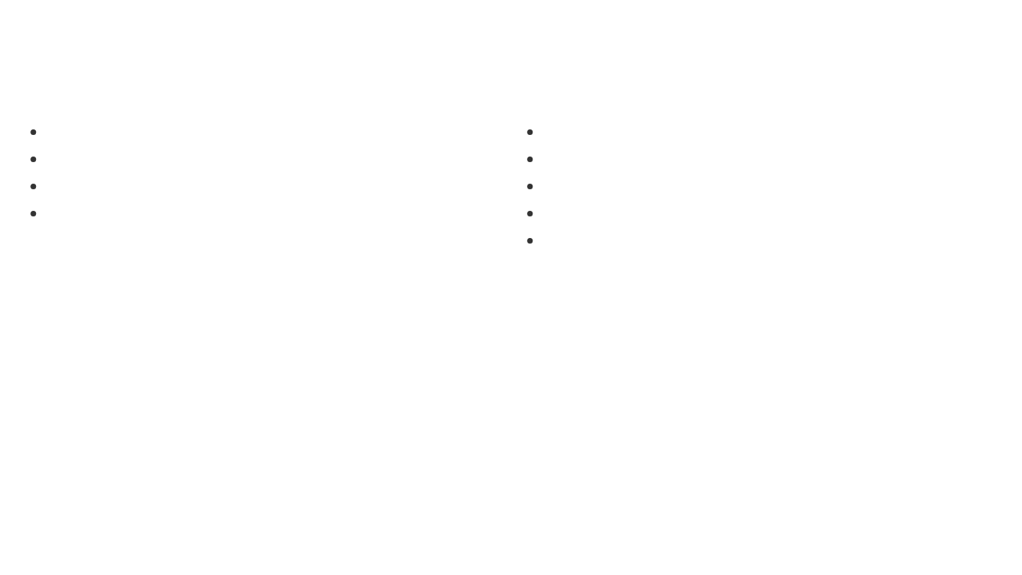


NDTV Scraping Example
Code Structure
Concepts Applied
setup_driver()
: Configures WebDriver with options
Multiple selectors
for robustness
scrape_ndtv_headlines()
: Gets headlines from homepage
Explicit waits
for dynamic content
scrape_article_content()
: Extracts full article data
Error handling
with try/except blocks
main()
: Orchestrates the scraping workflow
Data extraction
from text and attributes
Resource cleanup
with driver.quit()

Slide 13


Deep Dive: setup_driver() Function
Complete Function Code
Selenium Functions Explained
1. Options() Class
def setup_driver():
"""Setup Chrome driver with options"""
chrome_options = Options()
chrome_options = Options()
Creates a Chrome options object to configure browser behavior before launching.
# chrome_options.add_argument("--headless")
# chrome_options.add_argument("--no-sandbox")
2. Service() Class
# chrome_options.add_argument("--disable-dev-shm-usage")
Service(ChromeDriverManager().install())
service = Service(ChromeDriverManager().install())
Manages the ChromeDriver executable. ChromeDriverManager automatically downloads and installs the correct driver version.
driver = webdriver.Chrome(service=service, options=chrome_options)
# driver.delete_all_cookies()
# driver.refresh()
3. webdriver.Chrome()
return driver
webdriver.Chrome(service=service, options=chrome_options)
Creates a new Chrome WebDriver instance with specified service and options.
Optional Methods (Commented Out)
driver.delete_all_cookies()
- Clears all browser cookies
driver.refresh()
- Refreshes the current page

Slide 14

Deep Dive: Navigation and Waiting Functions
Navigation: driver.get()
Explicit Waiting: WebDriverWait
# Navigate to NDTV
# Wait for page to load
driver.get("https://www.ndtv.com")
WebDriverWait(driver, 10).until(
EC.presence_of_element_located((By.TAG_NAME, "body"))
# In article scraping function
)
driver.get(article_url)
# Wait for article to load
What driver.get() Does:
WebDriverWait(driver, 10).until(
Navigates to the specified URL
EC.presence_of_element_located((By.CSS_SELECTOR, ".Art-exp_cn"))
)
Waits for the page's
onload
event
Blocks execution until page is "ready"
WebDriverWait Components:
Returns control when DOM is loaded
Does NOT wait for AJAX or dynamic content
WebDriverWait(driver, 10)
- Wait up to 10 seconds
.until()
- Keep checking until condition is met
Important Note:
EC.presence_of_element_located()
- Expected condition
driver.get() only waits for initial page load, not for dynamic content that loads via JavaScript or AJAX calls.
(By.TAG_NAME, "body")
- Locator tuple
Expected Conditions Used:
presence_of_element_located
- Element exists in DOM
Polls every 500ms by default
Throws TimeoutException if condition not met
Why This Pattern?
Ensures specific elements are loaded before trying to interact with them, making the scraper more reliable.

Slide 15



Deep Dive: Element Finding Strategies
find_elements() - Multiple Elements
find_element() - Single Element
headline_selectors = ["h1 a", "h3 a"]
# Finding article title
title_element = driver.find_element(By.CSS_SELECTOR,
for
selector
in
headline_selectors:
"h1, .story-title, .article-title")
elements = driver.find_elements(By.CSS_SELECTOR, selector)
for
element
in
elements:
# Finding article container
title = element.text.strip()
article_container = driver.find_element(By.CSS_SELECTOR,
link = element.get_attribute("href")
".Art-exp_cn .Art-exp_wr")
find_elements() Behavior:
# Finding paragraphs within container
content_elements = article_container.find_elements(By.TAG_NAME, "p")
Returns a
list
of WebElement objects
Returns
empty list []
if no elements found
find_element() Behavior:
Never throws NoSuchElementException
Returns
first matching
WebElement
Searches entire DOM for matching elements
Throws
NoSuchElementException
if not found
CSS Selectors Used:
Stops searching after first match
"h1 a"
- Anchor tags inside h1 elements
Used when expecting exactly one element
"h3 a"
- Anchor tags inside h3 elements
Robustness Strategy:
Code uses multiple selectors and try/except blocks to handle different page structures gracefully.

Slide 16



Deep Dive: Data Extraction Methods
Text Extraction: element.text
Attribute Extraction & Filtering
# Extract headline title
# Extract href attribute
title = element.text.strip()
link = element.get_attribute("href")
# Extract article title
# Extract innerHTML for filtering
article_data["title"] = title_element.text.strip()
innerHTML = p.get_attribute("innerHTML").lower()
# Extract location
# Filter out ads and scripts
article_data["location"] = location_element.text.strip().replace(":", "")
if
text
and not any
(keyword
in
innerHTML
for
keyword
in
["script", "vdo.ai", "taboola", "vuukle"]):
# Extract paragraph content
clean_paragraphs.append(text)
for
p
in
content_elements:
text = p.text.strip()
# Join clean content
if
text:
article_data["content"] = "\n\n".join(clean_paragraphs)
clean_paragraphs.append(text)
get_attribute() Method:
element.text Behavior:
Returns
any HTML attribute
value
Returns
visible text content
only
Common attributes: href, src, class, id
Excludes hidden elements (display: none)
Returns
None
if attribute doesn't exist
Includes text from child elements
innerHTML
gets inner HTML content
Preserves whitespace and line breaks
Returns empty string if no text
Content Filtering:
Filters out script tags and ad content
Text Cleaning:
Uses
any()
function for multiple keywords
.strip()
- Removes leading/trailing whitespace
Ensures clean, readable content extraction
.replace(":", "")
- Removes specific characters
Validation with
if text:
checks

Slide 17


Deep Dive: Error Handling & Resource Management
Exception Handling Patterns
Resource Management
# Function-level error handling
# Proper resource cleanup
def
scrape_ndtv_headlines():
def
scrape_article_content(article_url):
driver = setup_driver()
driver = setup_driver()
try
:
# Main scraping logic
try
:
driver.get("https://www.ndtv.com")
driver.get(article_url)
# ... scraping code ...
# ... extraction logic ...
return
headlines
return
article_data
finally
:
driver.quit()
finally
:
driver.quit()
# Element-level error handling
for
element
in
elements:
# Alternative pattern with specific exceptions
try
:
try
:
title = element.text.strip()
title_element = driver.find_element(By.CSS_SELECTOR, "h1")
link = element.get_attribute("href")
article_data["title"] = title_element.text.strip()
except
Exception
as
e:
except
:
continue
article_data["title"] = "Title not found"
Exception Handling Strategy:
driver.quit() vs driver.close():
try/finally
- Ensures cleanup regardless of errors
driver.quit()
- Closes all windows and ends session
try/except/continue
- Skip problematic elements
driver.close()
- Closes current window only
Broad Exception
- Catches all element-related errors
quit() also terminates the driver process
Graceful degradation instead of crashing
Always use quit() for complete cleanup
Error Types Handled:
Why This Matters:
NoSuchElementException
Prevents memory leaks from unclosed browsers
StaleElementReferenceException
Avoids zombie driver processes
TimeoutException
Ensures clean system resource usage
WebDriverException
Critical for long-running scraping tasks

Slide 18


Conclusion and Next Steps
Key Takeaway
Selenium is a powerful tool not just for testing but for any web automation task including data extraction and web scraping.
What We've Covered
Next Steps
Selenium WebDriver architecture and components
Explore advanced selectors and XPath expressions
Setting up and configuring WebDriver
Learn handling of iframes and multiple windows
Navigation and page loading techniques
Implement Page Object Model design pattern
Element location strategies and waiting mechanisms
Integrate with testing frameworks (pytest, TestNG)
Data extraction and error handling approaches
Consider cloud-based testing platforms (Selenium Grid)
Real-world implementation with NDTV scraping example
Practice with different websites and scenarios

